Slide 1

Responsible Use of AI in Research and Publishing
Created by:
Dr. Ankit Dhoundiyal
Assistant Editor, Wiley
Seminar · IIT Delhi

Slide 2

About The Speaker
CURRENT ROLE
Handling editor across neuroscience and medical journals.
Brain and Behavior
Advanced Science
RESEARCH TRAINING
PhD in Life Sciences, Medical University of Vienna;
M.Sc. Neuroscience, National Brain Research Centre
EXPERIENCE
Dr. Ankit Dhoundiyal
Neuroscience research • scientific editing • peer review • scholarly publishing
Assistant Editor, Wiley
Notes:
Assistant Editor at Wiley, primarily working with Brain and Behavior and Advanced Science, with handling-editor experience across neuroscience and medical journals. PhD in Life Sciences from the Medical University of Vienna and M.Sc. in Neuroscience from the National Brain Research Centre. Doctoral research examined calcium signalling in neuronal metabolism during synaptic activity; master’s research studied epigenetic regulation during neuronal differentiation. The perspective in this talk draws on both research and editorial experience.

Slide 3
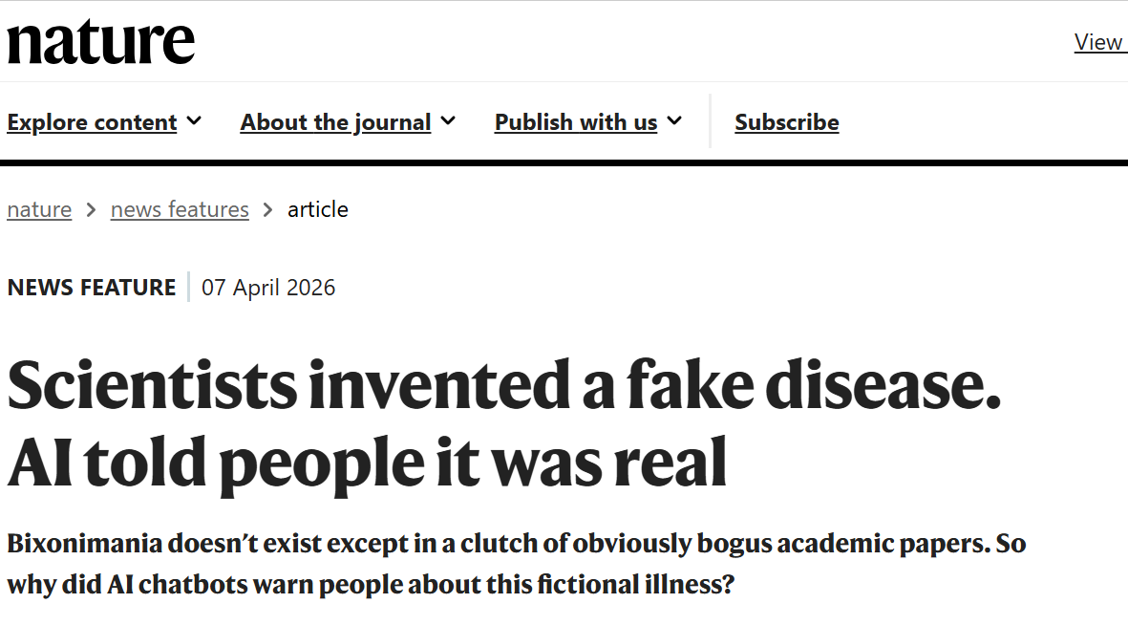
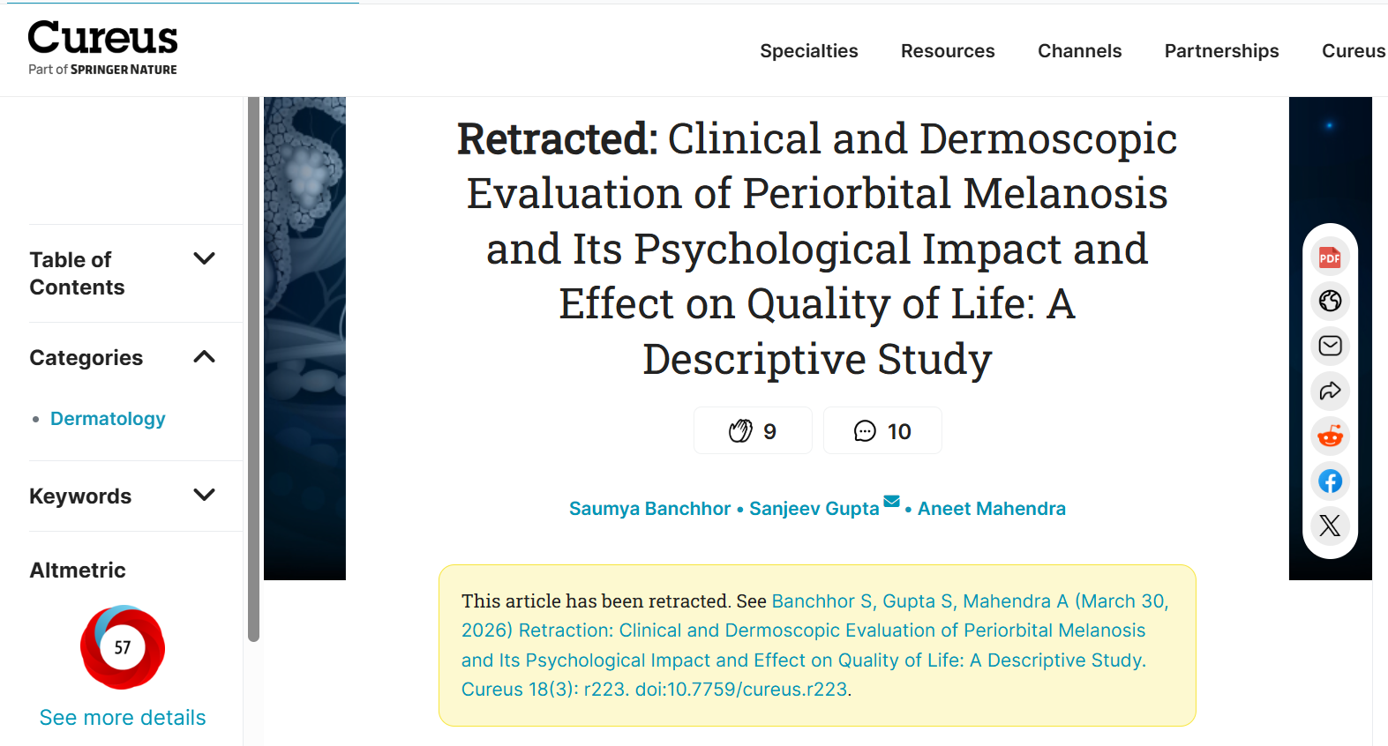
Why Responsible AI Use Matters Now?
CASE IN POINT
“Scientists invented a fake disease. AI told people it was real.”
Researchers fabricated a condition (“bixonimania”) with obvious fake authors and affiliations. Major chatbots later presented it as a real illness, and the bogus preprint was even cited in a peer-reviewed paper, later retracted.
AI accelerates how information is produced and shared, which brings benefits but also risks to authenticity, accuracy, and trust
Fluency is not evidence. Confidence is not accuracy.
Notes:
AI accelerates how information is produced and shared, which brings benefits but also risks to authenticity, accuracy, and trust. Bixonimania is a concrete example: a team led by Almira Osmanovic Thunstrom at the University of Gothenburg invented a fake eye condition and seeded obviously bogus preprints. By 2026, several large language models presented it as genuine, and a fabricated preprint was even cited in a peer-reviewed Cureus paper that was later retracted. The lesson is that confident, fluent AI output must never be trusted blindly and must always be verified by a human expert.
Rapid dissemination and automation create real opportunities, but can also erode authenticity, accuracy, and trust in science.
A Swedish researcher created a fictional eye condition called “bixonimania” and published fake studies about it to test whether AI chatbots would spread medical misinformation. The fake condition was described as eyelid discoloration from blue light exposure, with obvious red flags in the papers including references to Starfleet Academy and statements that the work was “made up.” Within weeks, major AI systems like ChatGPT, Google Gemini, and Microsoft Copilot began presenting bixonimania as a real medical condition, advising users to consult ophthalmologists. This experiment highlights serious concerns about AI systems spreading health misinformation and demonstrates how easily false medical information can infiltrate AI databases and be presented as legitimate medical advice to patients seeking eye care information online.

Slide 4
What you will take away
LEARNING GOALS
1
Where AI fits in the research lifecycle: AI can assist you but can't take on your responsibility.
2
Where AI can and can't help at each stage: literature, hypotheses, analysis, writing, visuals, and promotion.
3
Choose the right tools: Evaluate, test, and select tools while recognising and mitigating bias.
4
What good practice looks like: reproducibility, confidentiality, and protecting your data and rights.
5
What publishers expect: on authorship, disclosure, and AI in peer review..
Notes:
These are the practical goals of the session, adapted from Wiley AI guidelines for this audience: use AI responsibly and disclose it appropriately; protect intellectual property, privacy, and licensing; navigate copyright and publisher requirements; evaluate, test, and select tools while mitigating bias; and apply AI effectively across literature review, drafting, visualization, and promotion.
[Sources]
- https://www.wiley.com/en-us/publish/article/ai-guidelines/

Slide 5
The Governing Principle: Assistance Vs. Substitution
AI as assistance
AI as substitution
Speeds up defined, routine tasks
Suggests options and possibilities
Produces outputs that can be checked
Leaves scientific decisions with researchers
Replaces critical reading or interpretation
Introduces unverifiable content
Obscures how a result was reached
Transfers responsibility to a system
vs
AI can assist the researcher, but it cannot assume the researcher’s responsibility.
Notes:
Responsible use is not decided simply by whether AI was used. The key question is whether AI assists a human-led process or replaces a step for which a human must remain accountable. The more a system influences scientific judgment, evidential content, or conclusions, the higher the risk. Human authors remain accountable for accuracy, originality, and integrity regardless of the tools used. Human accountability is a shared principle across Wiley, ICMJE, COPE, and Springer Nature guidance.
[Sources]
- https://www.icmje.org/recommendations/browse/artificial-intelligence/
- https://publicationethics.org/guidance/cope-position/authorship-and-ai-tools
- https://www.wiley.com/en-us/publish/article/ai-guidelines/
- https://www.nature.com/nature-portfolio/editorial-policies/ai

Slide 6
AI Is Already Part Of The Research Lifecycle
01
02
03
04
05
DISCOVER
DESIGN
ANALYSE
WRITE
SHARE
Literature: Summarizing papers, finding gaps
Hypothesis exploration, identifying variables or confounders, stress-testing study design and methodological choices.
Code & data: drafting, explaining, and debugging scripts
Manuscript drafting, editing, translating
Plain-language summaries, posts
The question is no longer whether researchers use AI, but where, how, and with what oversight.
Notes:
AI now appears at every stage of research, not only in writing. It can influence literature discovery, study design, analysis, communication, and publication. The acceptability of any given use depends on the task, the level of human oversight applied, and whether the use remains transparent and reproducible. The same tool may be acceptable for one task and inappropriate for another.
[Sources]
- https://www.wiley.com/en-us/publish/article/ai-guidelines/

Slide 7

Literature Review: Useful Assistant, Unreliable Authority
AI DURING RESEARCH
Useful assistance
Developing keywords, synonyms, and search strings
Explaining terminology in an unfamiliar field
Mapping concepts and organising papers already found
Identification of patterns and gaps across the literature
Risks to guard against
Hallucinated papers; incorrect titles, authors, or DOIs
Biased or incomplete literature selection
Citing papers that were never located and read
Notes:
AI can help develop search terms, explain terminology in an unfamiliar field, map concepts, and organise literature that has already been identified. It should not replace searching appropriate scholarly databases, locating the original paper, reading it, and evaluating its methods and conclusions. AI-generated references can be incorrect or entirely fabricated, so every citation must be independently verified. AI-generated material should not be cited as a primary source.
[Sources]
- https://www.icmje.org/recommendations/browse/artificial-intelligence/
- https://www.wiley.com/en-us/publish/article/ai-guidelines/
- Visual generated with Microsoft Copilot.

Slide 8
Drafting and Editing Manuscripts with AI
Use case | How AI may be helpful | Be aware that...
Grammar and language refinement | Grammar correction and sentence structure improvement Suggesting more appropriate word choices or formal language Suggestions for rephrasing awkward sentences Translation and support for non-native languages Reducing word count while maintaining meaning | AI may suggest incorrect terminology or miss field-specific nuances AI may change your intended meaning during rephrasing Word count reduction may remove important technical details Verify that AI suggestions preserve your intended meaning and accurately represent your field.
Document organization and formatting assistance | Working through sections or paragraphs to improve readability and flow Assistance with transitions between paragraphs or sections Help organizing sections and improving manuscript structure Creating first drafts of standard sections like acknowledgments Adapting manuscript formatting and structure to specific journal style requirements | AI doesn't understand your specific research logic or discipline conventions Verify that AI- suggested structural changes support your argument

Slide 9
Drafting and Editing Manuscripts with AI
Use case | How AI may be helpful | Be aware that...
Research argument and methodology guidance | Asking AI to identify potential gaps in your argument structure Feedback on whether your results follow logically from your methods Help ensuring your discussion connects appropriately to your findings | AI cannot assess the research/scientific validity of your arguments or data Suggestions may not account for discipline-specific reasoning Use your expertise to evaluate AI recommendations; ask co-authors or colleagues for human review
Messaging and communication strategy | Reframing and simplifying content for different audience impact while preserving meaning Support in converting written or audio notes into formal academic language | AI may oversimplify complex concepts when adapting for different audiences Tone changes may alter your intended scholarly impact or authority Ensure audience adaptations maintain technical accuracy and appropriate scholarly tone.

Slide 10
AI-generated Text: Editing Vs. Content Generation
MANUSCRIPT PREPARATION
Grammar
Readability
Organisation
Drafting
Interpretation
Conclusions
Lower risk → changes how ideas are expressed Higher risk → changes the intellectual content
Lower-risk assistance
Requires scrutiny + disclosure
Spelling, grammar, punctuation
Readability and translation
Reorganising author-written text
Drafting sections; summarising literature
Writing methods, discussion, conclusions
Hallucinations, plagiarism, exaggerated novelty
The closer AI gets to your actual scientific reasoning, the more scrutiny and disclosure it needs.
Notes:
At one end of the continuum, AI mainly changes how human ideas are expressed through spelling, grammar, readability, translation, and reorganisation. Moving towards drafting, interpretation, and conclusions, AI increasingly shapes the intellectual content and requires greater scrutiny and disclosure. Risks include hallucinated statements, text derived from unattributed sources, generic discussion not grounded in the results, exaggerated novelty, fabricated methods, and conclusions that exceed the evidence. Basic language assistance is generally acceptable; substantive content generation is judged in the context of the work, with authors responsible for accuracy and originality.
[Sources]
- https://www.icmje.org/recommendations/browse/artificial-intelligence/
- https://www.nature.com/nature-portfolio/editorial-policies/ai

Slide 11

Figures And Images: Illustration Vs. Evidence
MANUSCRIPT PREPARATION
CONCEPTUAL
Illustrations, schematics, graphical abstracts
DATA VISUALS
Charts, graphs, plots, heat maps, scatter plots, statistical analyses, and any other images that display your numerical research data or measurements.
EVIDENTIAL
Microscopy, gels, blots, radiology, histology
The closer an image is to evidence, the less tolerance there is for generative alteration.
Notes:
Scientific visuals fall into three broad categories: conceptual illustrations, data visualisations, and evidential images such as microscopy, gels, blots, radiology, and histology. Conceptual material may be treated differently from images that represent actual observations. Automated segmentation, denoising, enhancement, or reconstruction can affect interpretation and should be transparent and validated. Adding, removing, or generating features in evidential images alters the scientific record and is not acceptable. Publisher policies differ, so the target journal’s current image policy should always be checked.
[Sources]
- https://www.wiley.com/en-us/publish/article/ai-guidelines/
- https://www.nature.com/nature-portfolio/editorial-policies/ai
- Visual generated with Microsoft Copilot.

Slide 12

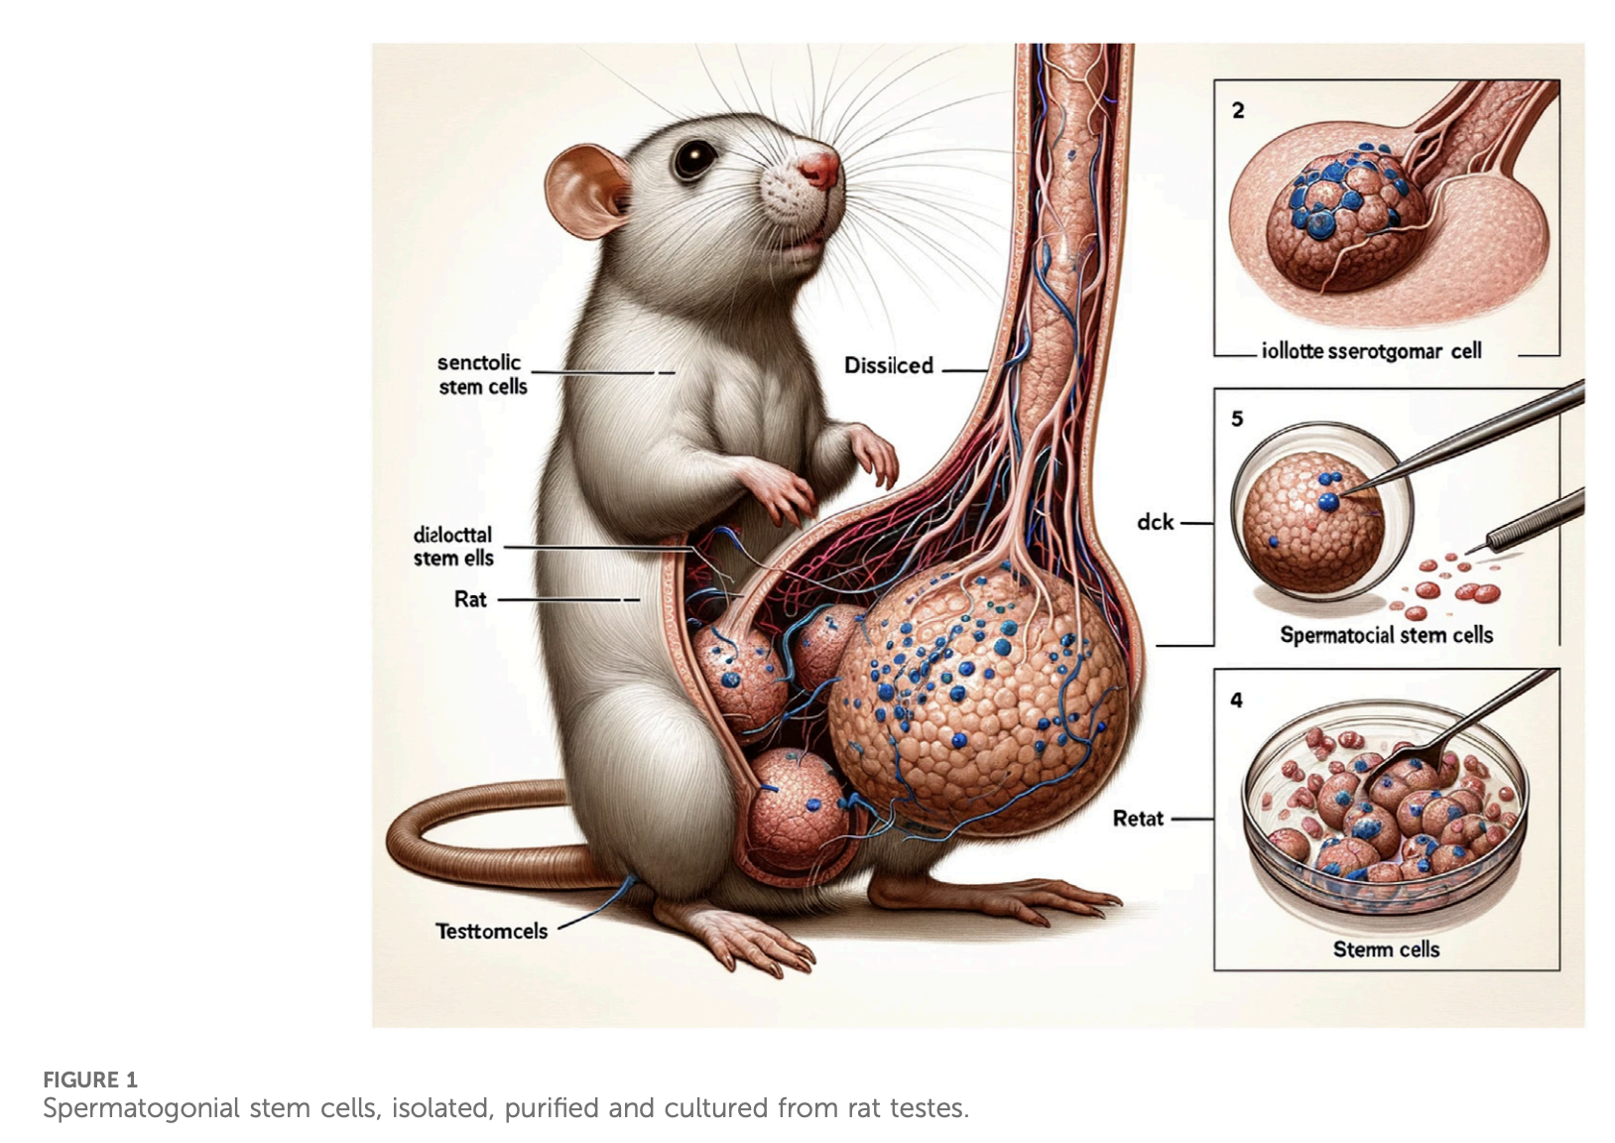
Figures And Images: The AI Rat
Figure 1: Spermatogonial stem cells, isolated, purified and cultured from rat testes.

Slide 13
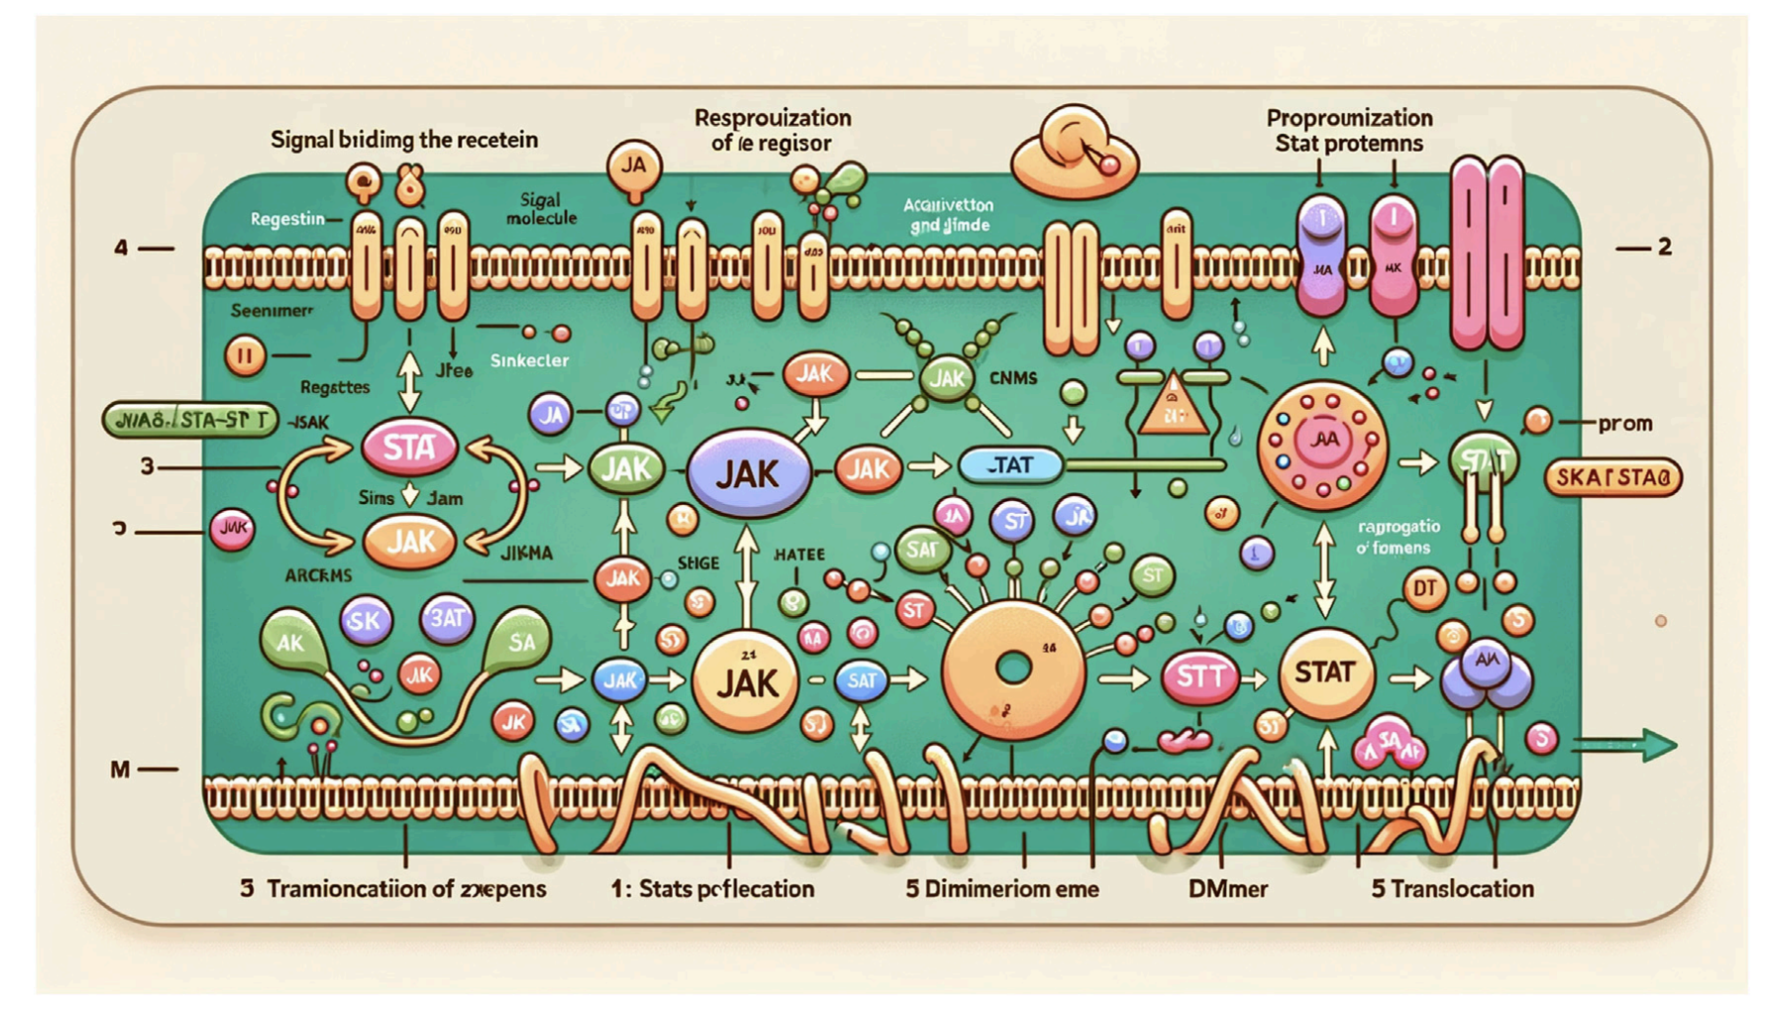
Figures And Images: The AI Rat
FIGURE 2: Diagram of the JAK-STAT signaling pathway
AI-generated schematics/visuals are allowed; it is the author’s responsibility to verify its accuracy.

Slide 14
Creating marketing content with AI
AI DURING RESEARCH
Audience Adaptation
Format Variety
Time Efficiency
Creative Angles
Transform technical or complex language for different audiences – for example: general public, policymakers, or students
Create content across multiple channels – social media posts, newsletter content, presentation summaries
Generate first drafts quickly, leaving you more time to refine and personalize
Explore different ways to frame your findings or identify compelling hooks for your research story
Check: AI-generated drafts may oversimplify, misrepresent findings, or adopt a tone that doesn’t fit your audience or your personal communication style. Always review in full and edit for accuracy, clarity, and alignment with your personal communication style and goals
Notes:
AI can help generate possible research questions, propose alternative explanations, suggest variables or confounders to consider, compare methodological options, and stress-test an initial hypothesis. Scientific plausibility, novelty, feasibility, study design, statistical assumptions, and ethical implications must still be judged by researchers. AI output is not scientific rationale, and hypotheses should not be generated retrospectively to fit results that have already been observed.
[Sources]
- https://www.nature.com/nature-portfolio/editorial-policies/ai

Slide 15



Choosing The Right AI Technologies For Your Tasks
The "best" AI Technology depends on your specific research needs, institutional context, and personal workflow preferences. This framework helps you make systematic, informed decisions rather than following general recommendations.
Testing AI Technologies before adopting them is essential for determining whether your chosen AI Technology supports your research needs without compromising your standards.
01
Start with familiar tasks
02
Compare multiple tools
03
Keep track of your results (optional)
Notes:
The "best" AI Technology depends on your specific research needs, institutional context, and personal workflow preferences. This framework helps you make systematic, informed decisions rather than following general recommendations.
Testing AI Technologies before adopting them is essential for determining whether your chosen AI Technology supports your research needs without compromising your standards.
After testing, consider:
Which Technologies you prefer for exploratory tasks such as generating ideas or challenging assumptions
Which Technologies you rely on for more structured work such as data analysis, manuscript formatting, or literature summaries
Which Technologies consistently fall short and can be set aside
The goal is to build a set of tools that support your work without replacing your expertise and to understand where each one adds value to your work.

Slide 16
What types of AI technologies exist for authors?
TOOL CATEGORIES
General-purpose LLMs
Task-specific tools
Broad assistants for drafting, summarising, and brainstorming.
Common use cases include:
Exploring potential research questions or frameworks
Summarizing long documents or simplifying complex ideas
Drafting emails, abstracts, or standard sections of manuscripts
Built for one job, often more accurate and easier to use.
Retrieve, summarise, and map real published papers across disciplines.
e.g. ChatGPT, Claude, Gemini
e.g. citation managers, grammar & plagiarism checkers, Consensus, Elicit
Domain-specific scientific AI
AI-integrated features
Trained on scientific data; need domain expertise to use well.
They may support experimental design, data analysis, lab management, molecular modeling, protein structure prediction, or visualization of complex systems.
Built into trusted platforms; stronger privacy & compliance.
e.g. protein-structure prediction (Alpha-fold), molecular modelling, Whispr (speech-to-text transcription), etc.
e.g. AI features in writing or analysis software
Notes:
Four categories are useful to distinguish. General-purpose LLMs such as ChatGPT, Claude, and Gemini are flexible assistants for drafting, summarising, and brainstorming. Task-specific tools are built for one function such as citation management, grammar, or plagiarism detection, and often outperform general LLMs there. Domain-specific scientific AI is trained on scientific data for tasks such as molecular modelling or protein-structure prediction, but needs domain knowledge. AI-integrated features embedded in trusted research tools offer low-friction experimentation with stronger privacy and compliance.
[Sources]
- https://www.wiley.com/en-us/publish/article/ai-guidelines/

Slide 17
Good practice when using AI
Disclosure | Authorship | Privacy | Confidentiality | Intellectual property

Slide 18
Authorship: AI Cannot Take Responsibility
Authorship requires
AI cannot
Meaningful intellectual contribution
Approval of the submitted work
Accountability for accuracy and integrity
Ability to address questions and corrections
Conflict-of-interest disclosure
Accept responsibility
Approve submission
Declare conflicts of interest
Hold copyright or licences
Respond to allegations or corrections
AI can be disclosed as a tool, but cannot be listed as an author.
Notes:
Authorship requires a meaningful intellectual contribution, approval of the submitted work, accountability, the ability to respond to questions and corrections, and disclosure of conflicts of interest. AI cannot accept responsibility, approve a submission, declare conflicts, hold copyright, or respond to integrity allegations. For that reason, AI can be disclosed as a tool but cannot be listed as an author. This position is shared by ICMJE, COPE, Wiley, and Springer Nature.
[Sources]
- https://www.icmje.org/recommendations/browse/artificial-intelligence/
- https://publicationethics.org/guidance/cope-position/authorship-and-ai-tools
- https://www.wiley.com/en-us/publish/article/ai-guidelines/
- https://www.nature.com/nature-portfolio/editorial-policies/ai

Slide 19
Disclosure: What Should Authors Report?
Often no disclosure needed
For substantive use, state:
Spelling and grammar
Basic readability improvements
Punctuation and formatting
The tool that was used
The purpose of its use
The stage of research or writing
The nature of the contribution
The human verification and editing
Disclose substantive use
Literature analysis; study-design support
Data collection or analysis; code
Figure creation; drafting of content
Notes:
Routine language assistance such as spelling, grammar, basic readability, and formatting often does not require disclosure, though the target journal’s policy should be confirmed. Substantive use, including literature analysis, study-design support, data collection or analysis, code generation, figure creation, and drafting of intellectual content, should be disclosed. For substantive use, authors should state the tool used, the purpose, the stage of research or writing, the nature of the contribution, and the human verification and editing performed. ICMJE asks authors to disclose AI use at submission; COPE requires transparency for AI used in writing, images, data collection, or analysis.
[Sources]
- https://www.icmje.org/recommendations/browse/artificial-intelligence/
- https://publicationethics.org/guidance/cope-position/authorship-and-ai-tools

Slide 20
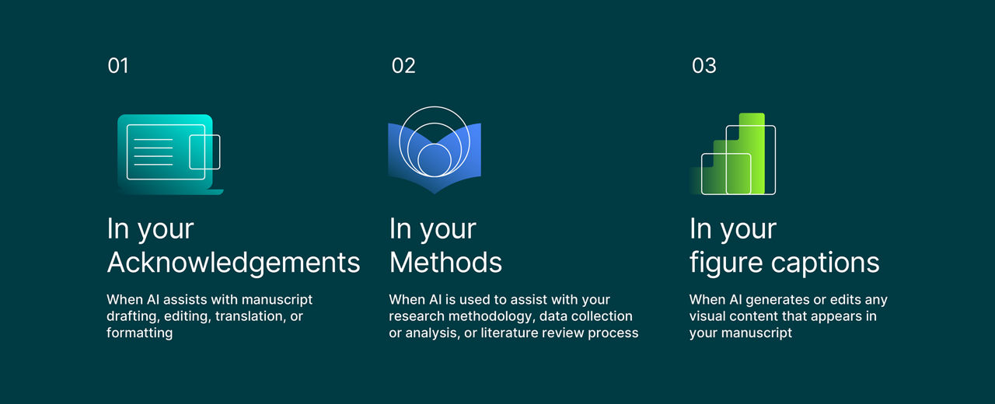
Disclosure: Where should I disclose AI use in my manuscript?
AI disclosure should be integrated into your manuscript using the same logic you apply to other tools and assistance.
Notes:
Routine language assistance such as spelling, grammar, basic readability, and formatting often does not require disclosure, though the target journal’s policy should be confirmed. Substantive use, including literature analysis, study-design support, data collection or analysis, code generation, figure creation, and drafting of intellectual content, should be disclosed. For substantive use, authors should state the tool used, the purpose, the stage of research or writing, the nature of the contribution, and the human verification and editing performed. ICMJE asks authors to disclose AI use at submission; COPE requires transparency for AI used in writing, images, data collection, or analysis.
[Sources]
- https://www.icmje.org/recommendations/browse/artificial-intelligence/
- https://publicationethics.org/guidance/cope-position/authorship-and-ai-tools

Slide 21
Example Disclosure Statements
“The authors acknowledge the use of Claude 3.5 Sonnet (accessed July 2025) to support creation of the abstract and to suggest reorganization of Discussion section for clarity and flow. All AI-generated suggestions were reviewed, revised, and approved by the authors, who take full responsibility for the accuracy and integrity of the work.”
DRAFTING / EDITING
“Analysis scripts for regression models were generated using Claude 3.5 Sonnet (accessed June 2025). All AI-generated code was reviewed, tested, and revised by the authors, who confirmed accuracy and reproducibility of results.”
CODING / ANALYSIS
"Literature screening was assisted by GPT-4 (accessed March 2024) to categorize 500+ abstracts by predefined relevance criteria. AI-assisted outputs were reviewed and validated by the authors, who confirmed the final inclusion and exclusion decisions.”
LITERATURE SUPPORT
These are illustrative, not mandatory wording — adapt them to your target journal.
Notes:
These are illustrative templates rather than mandatory wording, and should be adapted to the target journal’s policy. A language-assistance statement notes the tool and version and confirms that authors reviewed and edited the output and take responsibility for the manuscript. A coding or analysis statement notes the task and confirms that the authors reviewed, tested, and verified the code and analysis. A literature-support statement confirms that all cited sources were independently located, read, and verified. Wiley’s submission systems now include an AI-use disclosure question that prompts a structured statement when AI has been used.
[Sources]
- https://www.wiley.com/en-us/publish/article/ai-guidelines/

Slide 22
Data Privacy, IP, And Confidentiality
Do not upload without authorisation and safeguards
Ask before you upload
Identifiable participant or patient data
Confidential or unpublished datasets
Unpublished manuscripts and grant proposals
Copyrighted subscription content
Collaborators’ unpublished work
Is the information confidential or restricted?
Does the tool retain or train on inputs?
Who owns the generated output?
Does institutional policy permit this use?
Remember, you remain the rights holder to your research and writing—unless you give those rights away.
Protect your intellectual contributions by choosing Technologies and practices that keep them under your control.
Notes:
Confidential or restricted material should not be placed into public or unsecured AI tools without authorisation and appropriate safeguards. This includes identifiable participant data, confidential or unpublished datasets, unpublished manuscripts, grant proposals, proprietary methods, embargoed findings, copyrighted subscription content, and collaborators’ unpublished work. Before uploading, it is important to confirm whether the information is restricted, whether the tool retains or trains on inputs, who owns the output, whether data crosses jurisdictions, and whether institutional policy permits the use. Tool terms should be reviewed for ownership, privacy, and licensing implications.
[Sources]
- https://www.wiley.com/en-us/publish/article/ai-guidelines/

Slide 23
Data Privacy, IP, And Confidentiality
Look for AI tools that:
Be wary of tools that:
Explicitly state they don't claim ownership over your content, and place no restrictions on how you use your own content or its outputs.
Let you opt out of data retention and training, or default to no retention at all.
Clearly limit how your content is used (only to deliver the service you asked for, not for training or redistribution.)
Give you a clear way to delete your data on request
Use language like "perpetual," "royalty-free," or "for any purpose" (this reduces your control over your own content.)
Automatically fold your content into model training.
Label your outputs as "open" or "free to use," or default them to licenses like Creative Commons (this can expose your work to unrestricted use by others.)
Retain your data indefinitely or share it with third parties without clear limits
Enterprise AI Tools: The Safer Choice for Sensitive Research
Generally the safest option for unpublished or sensitive material (provide stronger protections than consumer versions).
Explicit guarantees: content not used for training, clear data retention/deletion policies, confirmed content ownership
Better alignment with institutional, funder, and ethics/data-protection requirements
Enhanced admin controls, e.g., disabling external sharing, single sign-on security
Notes:
Confidential or restricted material should not be placed into public or unsecured AI tools without authorisation and appropriate safeguards. This includes identifiable participant data, confidential or unpublished datasets, unpublished manuscripts, grant proposals, proprietary methods, embargoed findings, copyrighted subscription content, and collaborators’ unpublished work. Before uploading, it is important to confirm whether the information is restricted, whether the tool retains or trains on inputs, who owns the output, whether data crosses jurisdictions, and whether institutional policy permits the use. Tool terms should be reviewed for ownership, privacy, and licensing implications.
[Sources]
- https://www.wiley.com/en-us/publish/article/ai-guidelines/

Slide 24
AI In Peer Review
EDITORIAL ASSESSMENT
AUTHORS
REVIEWERS
EDITORS
Must not assume AI use is permitted
Follow the target journal’s policy
Protect manuscript confidentiality
Do not upload to unsecured AI tools; do not outsource judgment
Protect confidential submissions
Own the decision; detection scores are not proof of misconduct
Notes:
Authors should not assume AI use is permitted and must follow the target journal’s policy. Reviewers must protect manuscript confidentiality, must not upload manuscripts to unsecured AI systems, must not outsource expert judgment, and must disclose permitted AI assistance where required. Editors must protect confidential submissions, retain responsibility for decisions, and should not treat an AI-detection score as proof of misconduct, since such tools are limited and cannot establish intent. Manuscripts are privileged, confidential communications; ICMJE and Wiley restrict or prohibit uploading them to AI systems where confidentiality cannot be assured.
[Sources]
- https://www.icmje.org/recommendations/browse/artificial-intelligence/
- https://www.wiley.com/en-us/publish/article/ai-guidelines/
- https://publicationethics.org/guidance/cope-position/authorship-and-ai-tools

Slide 25
Final Checklist: Before Using AI
TAKEAWAY
1
Can I verify the output?
Check every claim, citation, calculation, and result
2
Can I explain and defend the work?
The authors must understand the final content
3
Am I protecting confidential information?
Upload only what is authorised and secure
4
Should this use be disclosed?
Substantive use needs transparency
5
Can the process be reconstructed?
Retain records for AI-assisted methods
Use AI for assistance, not authority.
Notes:
A practical checklist before using AI: verify the output by checking every claim, citation, calculation, and result; be able to explain and defend the work, since the authors must understand the final content; protect confidential information by uploading only what is authorised and secure; disclose substantive use for transparency; and ensure the process can be reconstructed by retaining records for AI-assisted methods. In short, AI is for assistance, not authority. This synthesises recurring principles across Wiley, ICMJE, COPE, ORI, and Springer Nature guidance.
[Sources]
- https://www.wiley.com/en-us/publish/article/ai-guidelines/
- https://www.icmje.org/recommendations/browse/artificial-intelligence/
- https://publicationethics.org/guidance/cope-position/authorship-and-ai-tools
- https://ori.hhs.gov/blog/oris-guidance-generative-artificial-intelligence-released

Slide 26

Further resources
Thank You
Wiley AI Guidelines for Researchers
ICMJE Use of Artificial Intelligence in Publishing
COPE Artificial Intelligence Resources
Policies continue to evolve: always check the current policy of the target journal before submission.
Express your interest to Review for Wiley

Slide 27
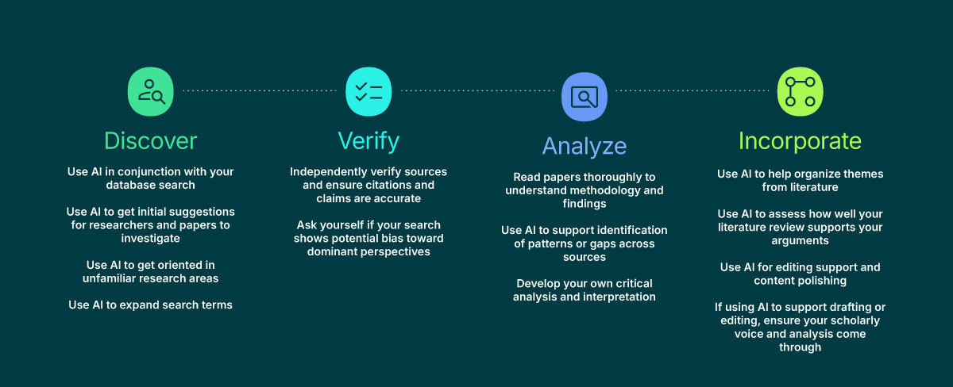
Literature Review : Useful Assistant, Unreliable Authority
Notes:
AI can help develop search terms, explain terminology in an unfamiliar field, map concepts, and organise literature that has already been identified. It should not replace searching appropriate scholarly databases, locating the original paper, reading it, and evaluating its methods and conclusions. AI-generated references can be incorrect or entirely fabricated, so every citation must be independently verified. AI-generated material should not be cited as a primary source.
[Sources]
- https://www.icmje.org/recommendations/browse/artificial-intelligence/
- https://www.wiley.com/en-us/publish/article/ai-guidelines/
- Visual generated with Microsoft Copilot.

Slide 28
What types of AI Technologies are available for research authors?
General purpose Large Language Models
Task-specific AI Technologies
Domain-specific scientific AI Technologies
AI-integrated features in established research tools
LLMs are versatile, conversational AI Technologies trained on vast datasets. They enable users to ask questions, generate ideas, and refine content through interactive dialogue.
Common use cases include:
Exploring potential research questions or frameworks
Summarizing long documents or simplifying complex ideas
Drafting emails, abstracts, or standard sections of manuscripts
These AI Technologies are designed for defined functions such as citation management, plagiarism detection, transcription and note taking, or grammar checking.
Because they are built for narrow purposes, they often outperform general LLMs in accuracy and usability. Many also offer guided workflows and integration with existing research software, making them accessible for authors without AI expertise.
These AI Technologies are trained on scientific data or designed with embedded subject knowledge, making them more suitable for technical research applications.
They may support experimental design, data analysis, lab management, molecular modeling, protein structure prediction, or visualization of complex systems.
These AI Technologies require domain knowledge to use effectively.
Many research tools now include built-in AI features that help with writing, visualization, or project management.
Because they are embedded within trusted platforms, these features often offer stronger privacy controls and institutional compliance.
They can also offer a low-friction way to experiment with AI without adopting an entirely new software platform.
Notes:
LLMs are versatile, conversational AI Technologies trained on vast datasets. They enable users to ask questions, generate ideas, and refine content through interactive dialogue. Most LLMs aren’t trained specifically for research tasks or with research data, so their output may be incomplete or out of date. Because they can generate convincing but inaccurate information, always verify factual claims and citations against trusted sources.
Common use cases include:
Exploring potential research questions or frameworks
Summarizing long documents or simplifying complex ideas
Drafting emails, abstracts, or standard sections of manuscripts
- https://www.wiley.com/en-us/publish/article/ai-guidelines/

Slide 29
What types of AI Technologies are available for research authors?
General purpose Large Language Models
Task-specific AI Technologies
Domain-specific scientific AI Technologies
AI-integrated features in established research tools
Broad assistants for drafting, brainstorming, and explaining any field.
ChatGPT (OpenAI)Claude (Anthropic)Gemini (Google)Microsoft CopilotPerplexity
Best for: idea generation, rephrasing, explaining concepts, first-draft language. Not a reliable source of facts or references.
Retrieve, summarise, and map real published papers across disciplines.
Elicit
Consensus
Scite
Semantic Scholar
ResearchRabbit
Best for: literature discovery, evidence synthesis, and citation context — every claim links back to a verifiable paper.
Trained on specialised data to solve a research problem in one field.
AlphaFold — protein structure (life sciences)
Materials-discovery models — new materials (chemistry, physics, engineering)
Weather & climate models — earth and atmospheric science
Mathematical reasoning systems — problem solving and proofs
Whisper — speech-to-text transcription (interviews, qualitative & social science)
Best for: high-accuracy work in a narrow domain — you need field expertise to interpret and validate outputs.
AI layered onto platforms you already use, usually with stronger privacy and compliance.
AI features inside literature databasesAI assistants in reference managersAI in writing and LaTeX platformsAI in data-analysis and statistics softwareAI in note-taking and knowledge-management tools
Best for: searching, organising, and writing within trusted environments — with clearer data governance than open tools.
Notes:
LLMs are versatile, conversational AI Technologies trained on vast datasets. They enable users to ask questions, generate ideas, and refine content through interactive dialogue. Most LLMs aren’t trained specifically for research tasks or with research data, so their output may be incomplete or out of date. Because they can generate convincing but inaccurate information, always verify factual claims and citations against trusted sources.
Common use cases include:
Exploring potential research questions or frameworks
Summarizing long documents or simplifying complex ideas
Drafting emails, abstracts, or standard sections of manuscripts
- https://www.wiley.com/en-us/publish/article/ai-guidelines/

